Slide 1
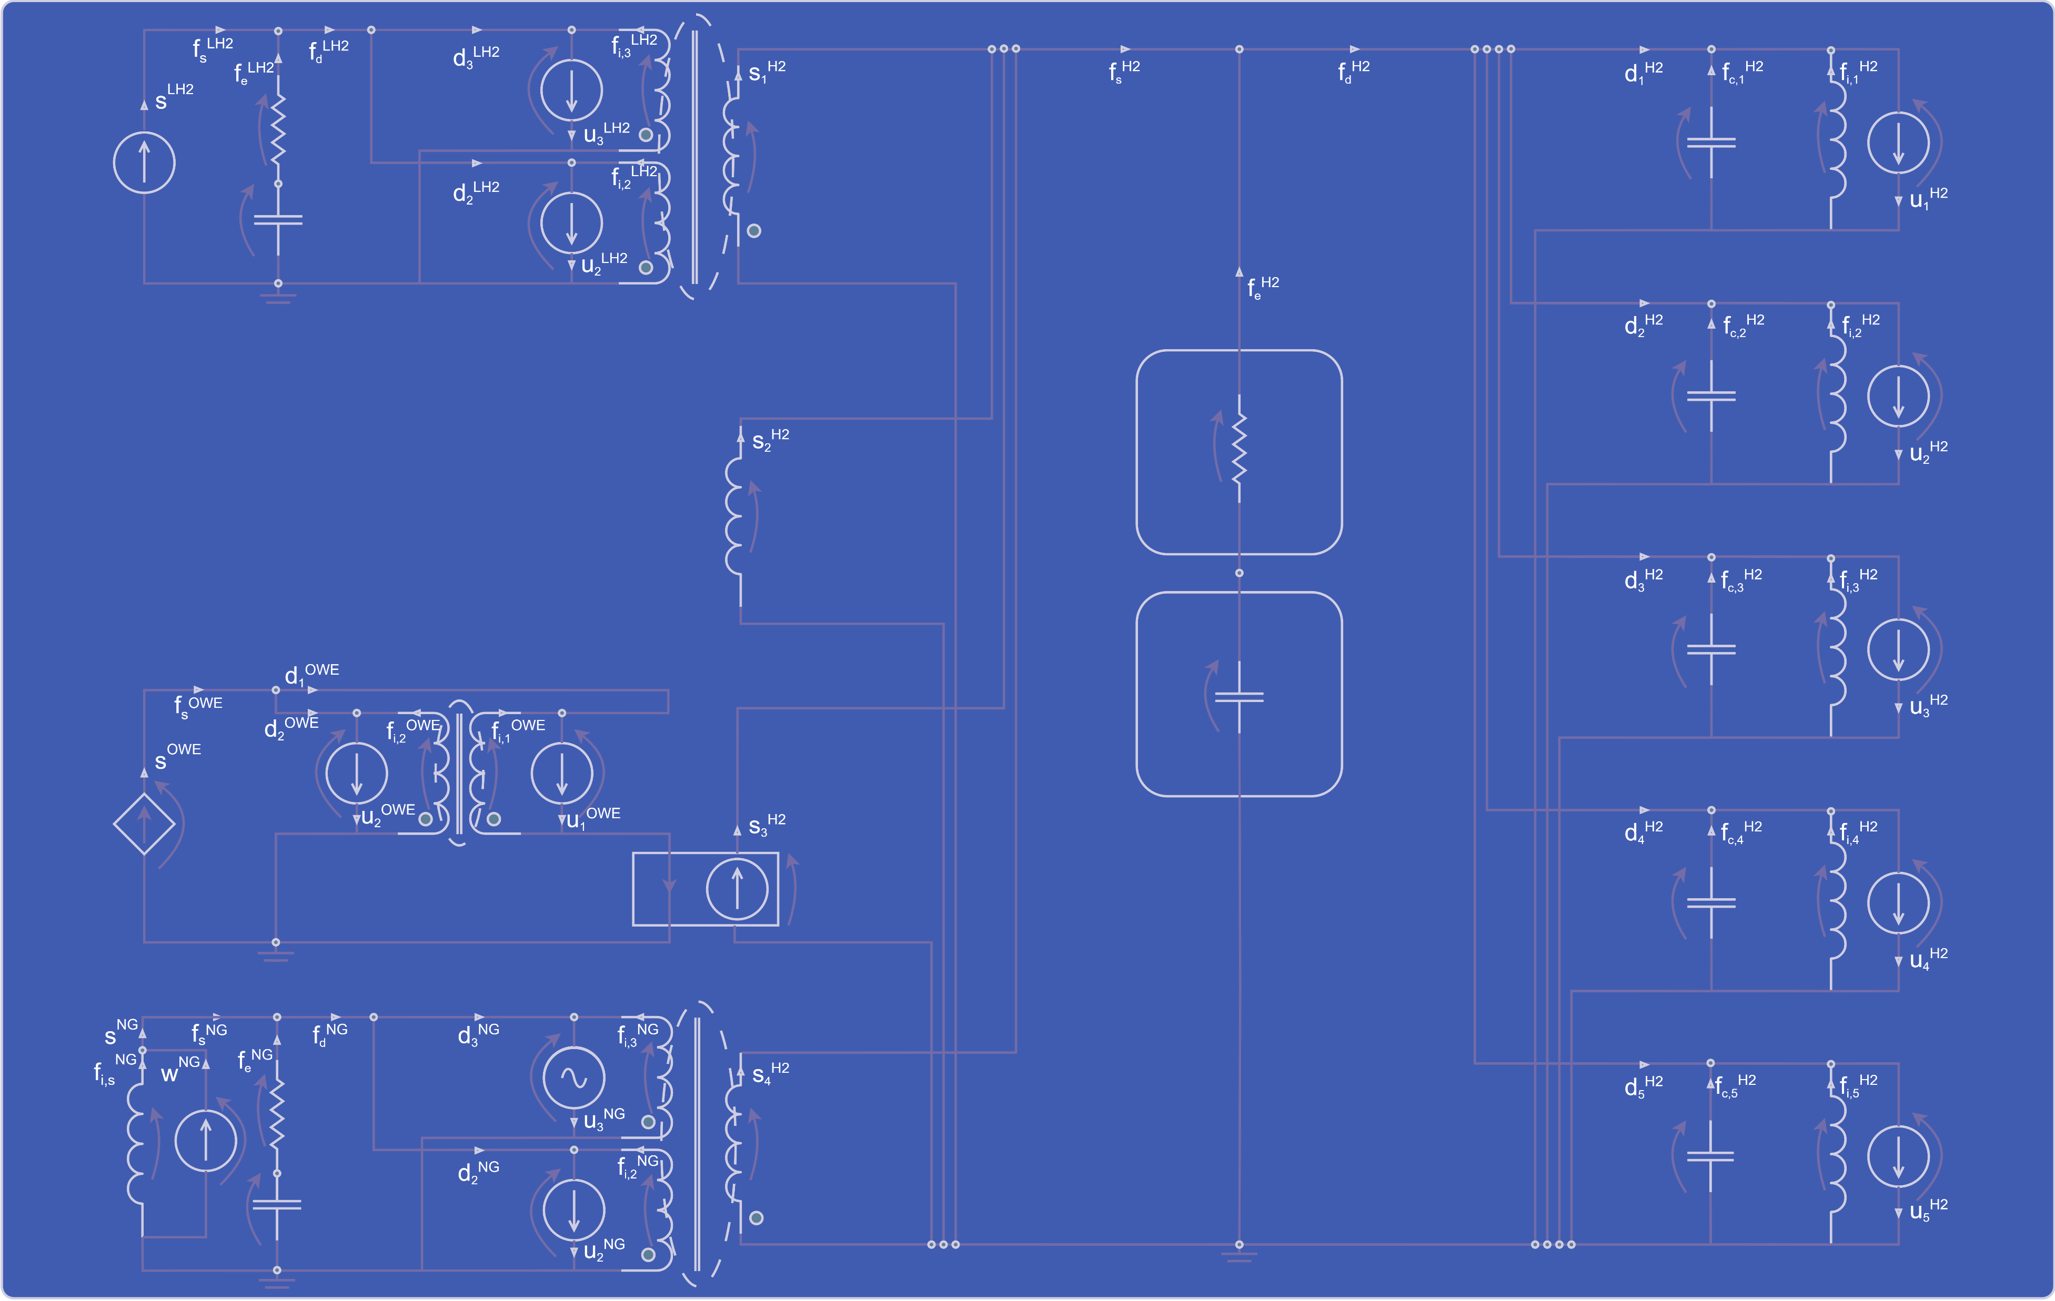
Modeling, Design, Analysis, and Control of a Spot Market for Hydrogen
An Application of Economic Circuit Theory
Pien van den Berkmortel 03-07-2024

Slide 2
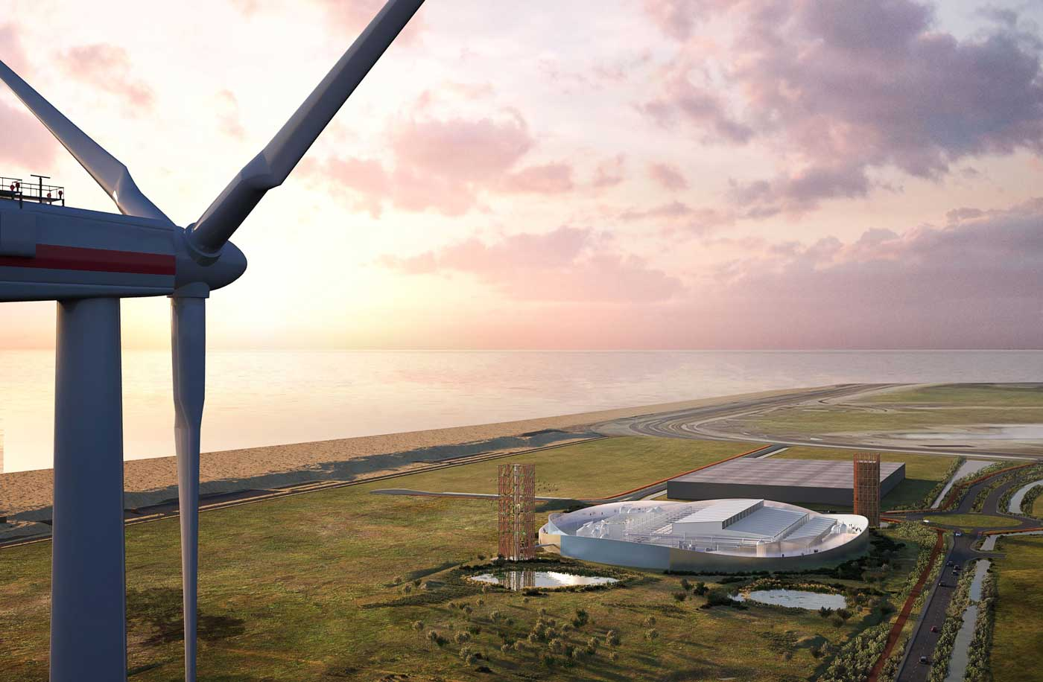
Hydrogen as Part of the Energy Transition
Context | Problem statement | ECT | Modeling & Design | Analysis | Control | Conclusions

Slide 3



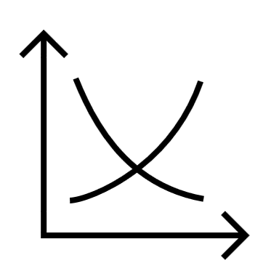



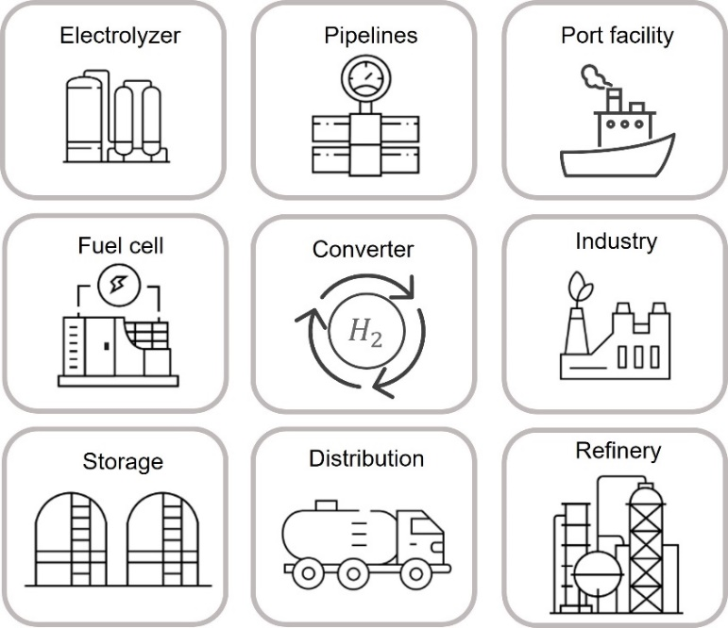
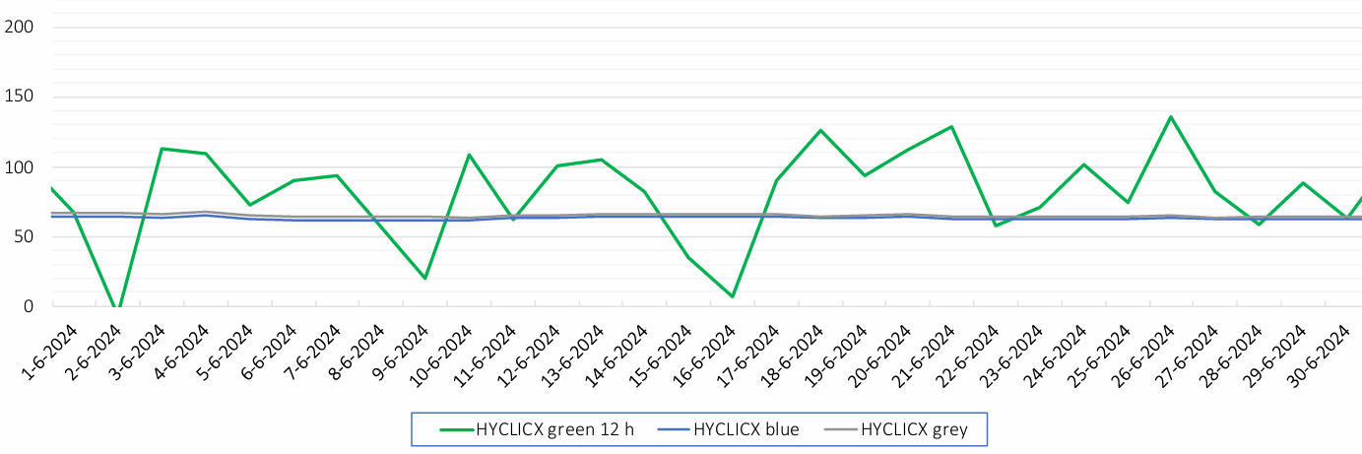
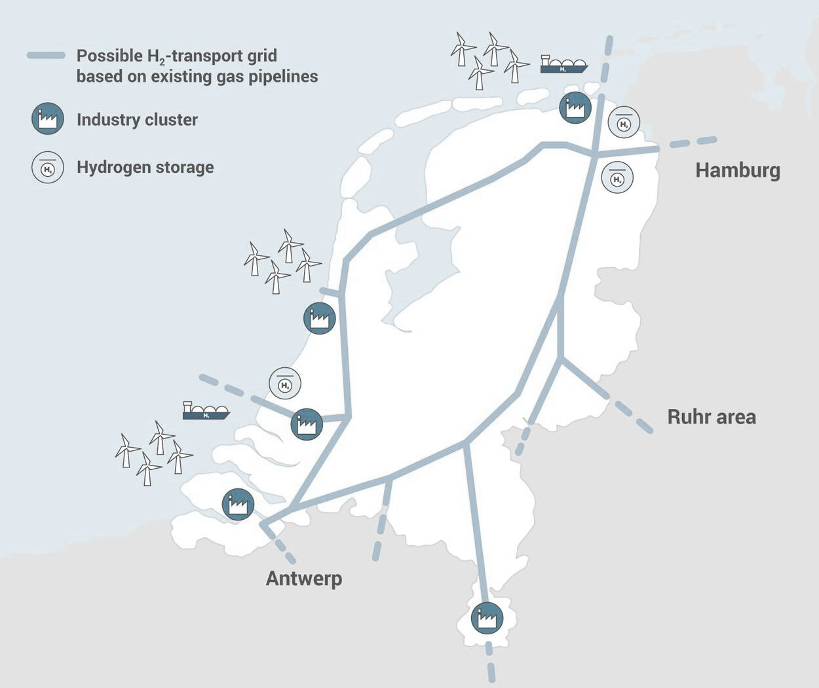
From Cost-Plus to Supply-and-Demand-Driven Pricing
Future market:
A spot market
Dynamic hydrogen price
Real-time balancing of supply and demand
Current market:
Long-term contracts
Fixed hydrogen price
Predictable revenue streams
€
€
Problem:
Integration of renewable hydrogen
Problem:
Unpredictable revenue streams
Increased volatility in hydrogen supply and prices
€/MWh
[3]
Context | Problem statement | ECT | Modeling & Design | Analysis | Control | Conclusions

Slide 4





Economic Circuit Theory for Spot Market Modeling
Analysis:
Address unpredictability
Energy prices, storage levels, and energy flows
Dynamic resilience [6]
Modeling and Design:
Supply-and-demand-driven pricing
Modular framework
€
Price effects [4]
Spot market design [5]
[6] UNECE, “Building Resilient Energy Systems.” 2023.
Control:
Minimize volatility
Regulatory intervention [7]
[4] B. Koirala, et. al, “Integrated electricity, hydrogen and methane system modelling framework: Application to the Dutch Infrastructure Outlook 2050,” Applied Energy, 2021. [5] IRENA, “Making the breakthrough: Green hydrogen policies and technology costs,” International Renewable Energy Agency, 2021.
[7] Roland Berger, “Making the Hydrogen Market: Requirements for the Netherlands to become a hydrogen hub,” tech. rep., 2022.
$H_{2}$
Context | Problem statement | ECT | Modeling & Design | Analysis | Control | Conclusions

Slide 5
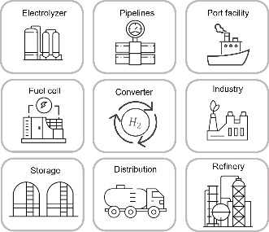


The Backbone as a Blueprint for Electrical Networks
Import by ship
Wind farm
Import by pipe
$${HA}_{2}$$
Renewable hydrogen production
€
Low-carbon hydrogen production
Market operator
Central hydrogen storage
$${HA}_{2}$$
Industrial demand
Local hydrogen storage
Context | Problem statement | ECT | Modeling & Design | Analysis | Control | Conclusions

Slide 6
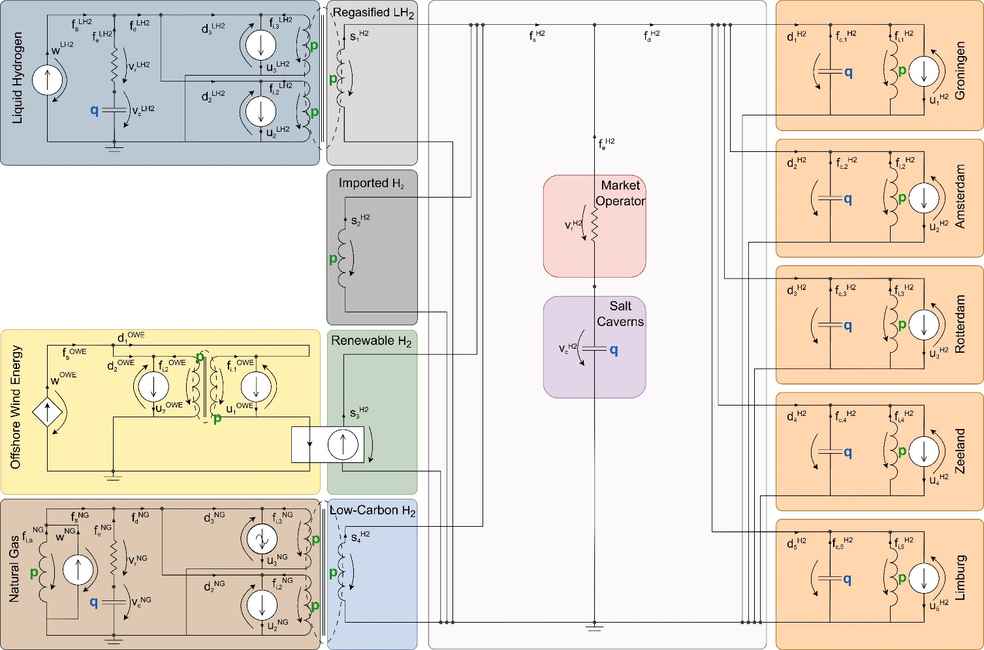
A Hydrogen Spot Market as an Electrical Network
Import by ship
Wind farm
Import by pipe
Renewable hydrogen production
Low-carbon hydrogen production
Market operator
Central hydrogen storage
$${HA}_{2}$$
$${HA}_{2}$$
Industrial demand
Local hydrogen storage
Context | Problem statement | ECT | Modeling & Design | Analysis | Control | Conclusions

Slide 7
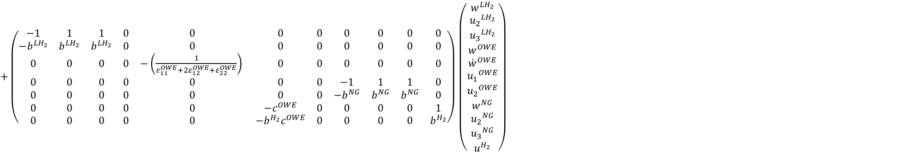
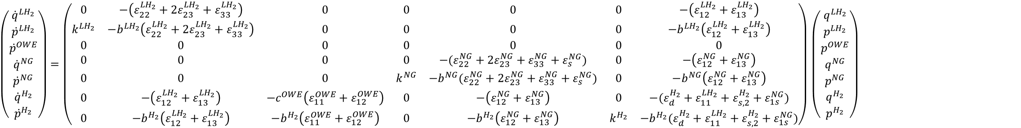
The Dynamics of Energy Prices and Storage Levels
$\left(\begin{matrix}{\dot{q}}^{{LH}_{2}} \\ {\dot{p}}^{{LH}_{2}} \\ {\dot{p}}^{OWE} \\ {\dot{q}}^{NG} \\ {\dot{p}}^{NG} \\ {\dot{q}}^{H_{2}} \\ {\dot{p}}^{H_{2}}\end{matrix}\right)=\left(\begin{matrix}0 & −\left(ε_{22}^{{LH}_{2}}+{2ε}_{23}^{{LH}_{2}}+ε_{33}^{{LH}_{2}}\right) & 0 & 0 & 0 & 0 & −\left(ε_{12}^{{LH}_{2}}+ε_{13}^{{LH}_{2}}\right) \\ k^{{LH}_{2}} & −b^{{LH}_{2}}\left(ε_{22}^{{LH}_{2}}+{2ε}_{23}^{{LH}_{2}}+ε_{33}^{{LH}_{2}}\right) & 0 & 0 & 0 & 0 & −b^{{LH}_{2}}\left(ε_{12}^{{LH}_{2}}+ε_{13}^{{LH}_{2}}\right) \\ 0 & 0 & 0 & 0 & 0 & 0 & 0 \\ 0 & 0 & 0 & 0 & −(ε_{22}^{NG}+{2ε}_{23}^{NG}+ε_{33}^{NG}+ε_{s}^{NG}) & 0 & −\left(ε_{12}^{NG}+ε_{13}^{NG}\right) \\ 0 & 0 & 0 & k^{NG} & −b^{NG}(ε_{22}^{NG}+{2ε}_{23}^{NG}+ε_{33}^{NG}+ε_{s}^{NG}) & 0 & −b^{NG}\left(ε_{12}^{NG}+ε_{13}^{NG}\right) \\ 0 & −\left(ε_{12}^{{LH}_{2}}+ε_{13}^{{LH}_{2}}\right) & −c^{OWE}\left(ε_{11}^{OWE}+ε_{12}^{OWE}\right) & 0 & −\left(ε_{12}^{NG}+ε_{13}^{NG}\right) & 0 & −(ε_{d}^{H_{2}}+ε_{11}^{{LH}_{2}}+ε_{s,2}^{H_{2}}+ε_{1s}^{NG}) \\ 0 & −b^{H_{2}}\left(ε_{12}^{{LH}_{2}}+ε_{13}^{{LH}_{2}}\right) & −b^{H_{2}}\left(ε_{11}^{OWE}+ε_{12}^{OWE}\right) & 0 & −b^{H_{2}}\left(ε_{12}^{NG}+ε_{13}^{NG}\right) & k^{H_{2}} & −b^{H_{2}}(ε_{d}^{H_{2}}+ε_{11}^{{LH}_{2}}+ε_{s,2}^{H_{2}}+ε_{1s}^{NG})\end{matrix}\right)$ $\left(\begin{matrix}q^{{LH}_{2}} \\ p^{{LH}_{2}} \\ p^{OWE} \\ q^{NG} \\ p^{NG} \\ q^{H_{2}} \\ p^{H_{2}}\end{matrix}\right)$
$+\left(\begin{matrix}−1 & 1 & 1 & 0 & 0 & 0 & 0 & 0 & 0 & 0 & 0 \\ −b^{{LH}_{2}} & b^{{LH}_{2}} & b^{{LH}_{2}} & 0 & 0 & 0 & 0 & 0 & 0 & 0 & 0 \\ 0 & 0 & 0 & 0 & −\left(\frac{1}{ε_{11}^{OWE}+2ε_{12}^{OWE}+ε_{22}^{OWE}}\right) & 0 & 0 & 0 & 0 & 0 & 0 \\ 0 & 0 & 0 & 0 & 0 & 0 & 0 & −1 & 1 & 1 & 0 \\ 0 & 0 & 0 & 0 & 0 & 0 & 0 & −b^{NG} & b^{NG} & b^{NG} & 0 \\ 0 & 0 & 0 & 0 & 0 & −c^{OWE} & 0 & 0 & 0 & 0 & 1 \\ 0 & 0 & 0 & 0 & 0 & −b^{H_{2}}c^{OWE} & 0 & 0 & 0 & 0 & b^{H_{2}}\end{matrix}\right)$ $\left(\begin{matrix}w^{{LH}_{2}} \\ {u_{2}}^{{LH}_{2}} \\ {u_{3}}^{{LH}_{2}} \\ w^{OWE} \\ {\dot{w}}^{OWE} \\ {u_{1}}^{OWE} \\ {u_{2}}^{OWE} \\ w^{NG} \\ {u_{2}}^{NG} \\ {u_{3}}^{NG} \\ u^{H_{2}}\end{matrix}\right)$
Context | Problem statement | ECT | Modeling & Design | Analysis | Control | Conclusions

Slide 8
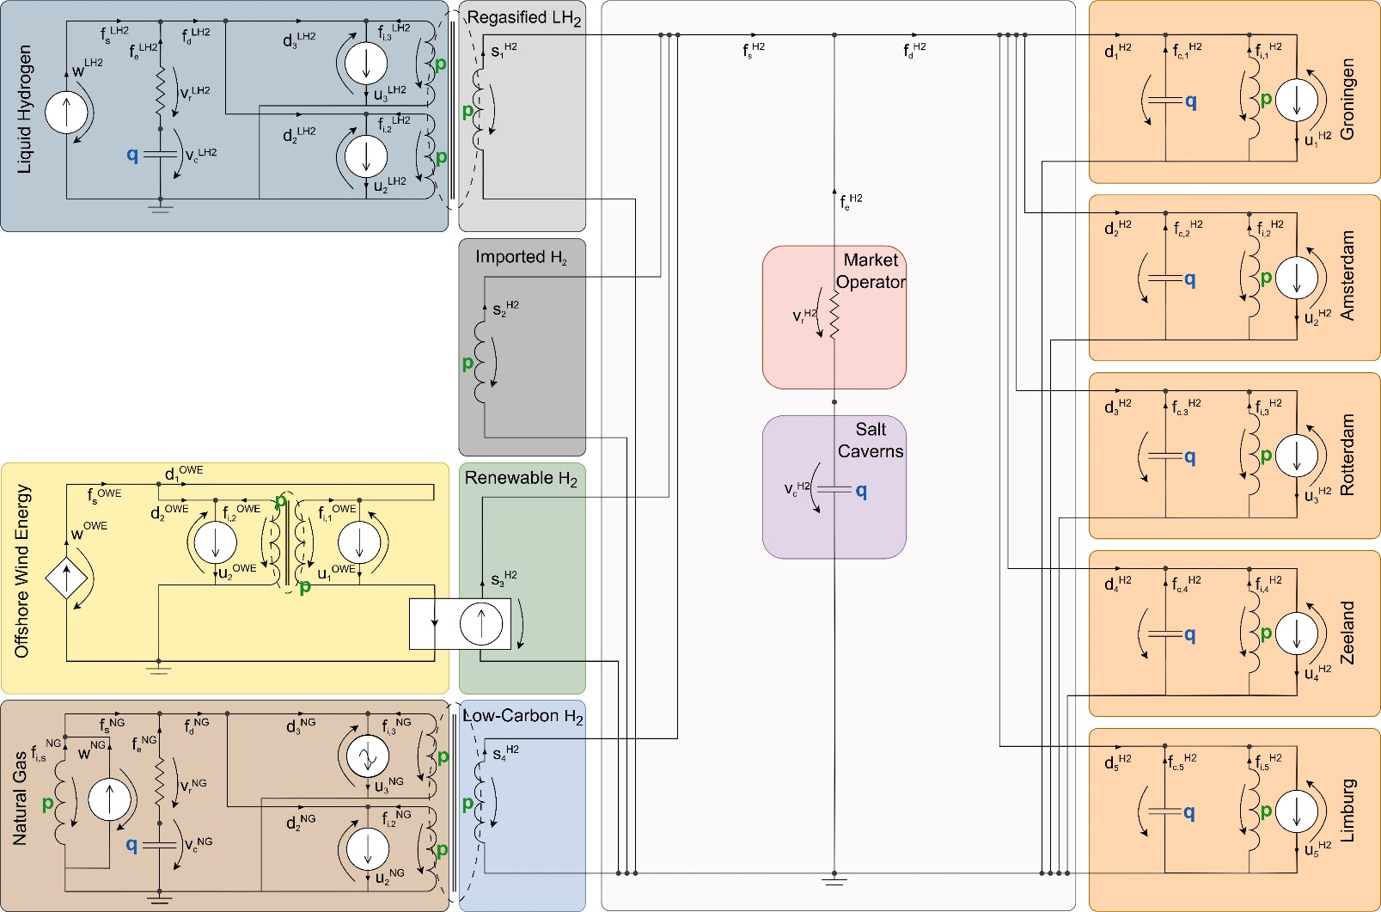
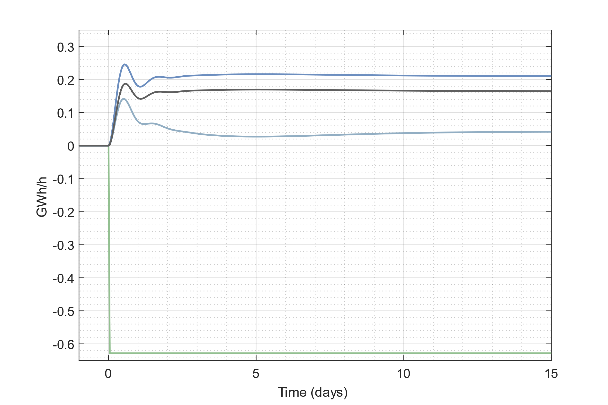
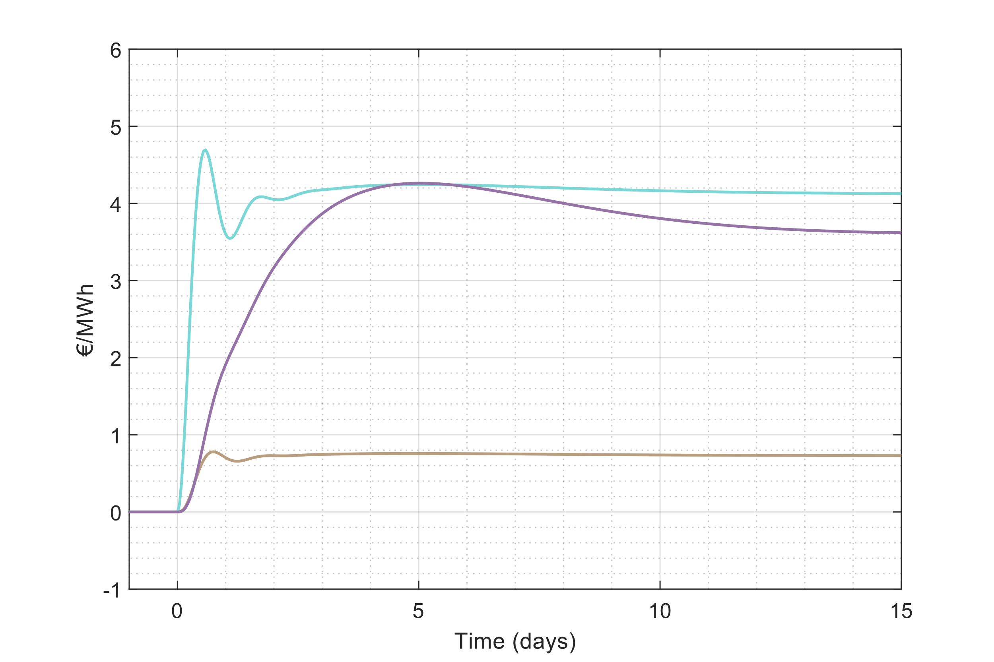
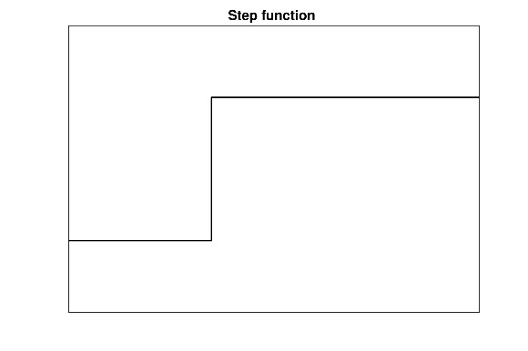
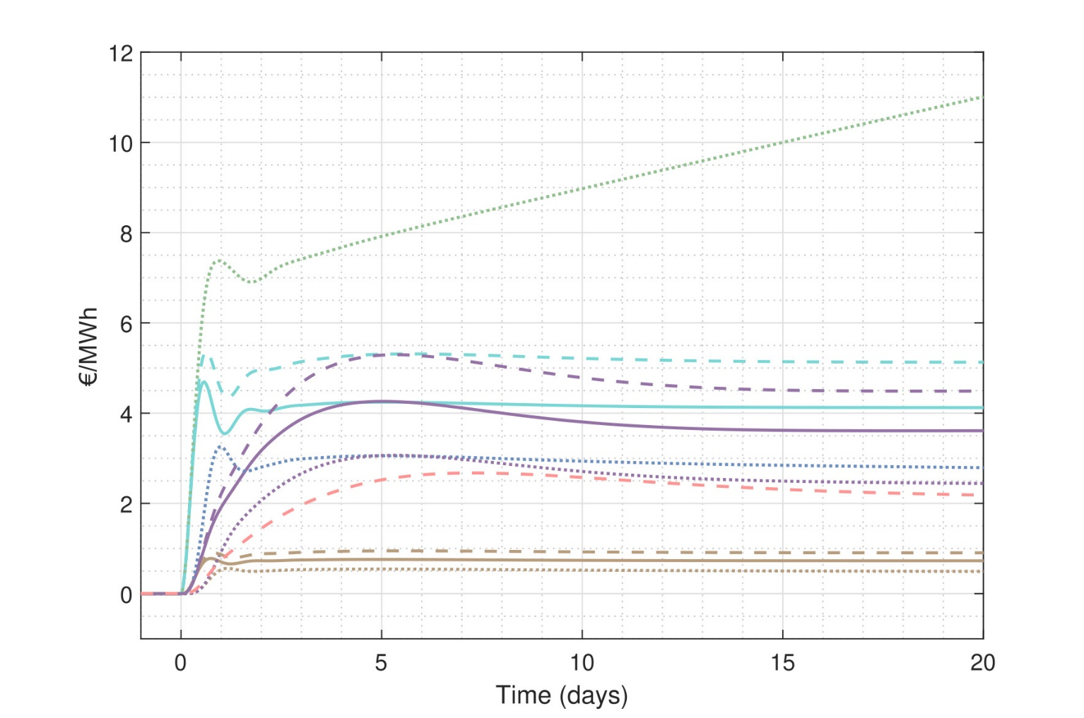
Dynamic Scenario Analysis: Dynamic Resilience
A
Hydrogen supply
Energy prices
V
A
V
A
A
V
Renewable
Low-carbon
Imported H2
Regasified H2
Hydrogen (all)
Liquid hydrogen
Natural gas
Context | Problem statement | ECT | Modeling & Design | Analysis | Control | Conclusions

Slide 9
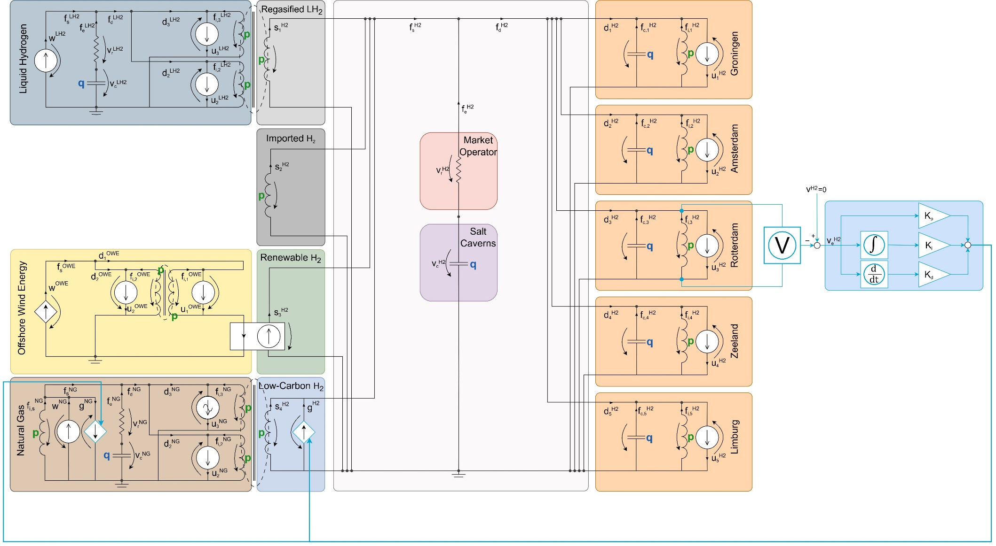
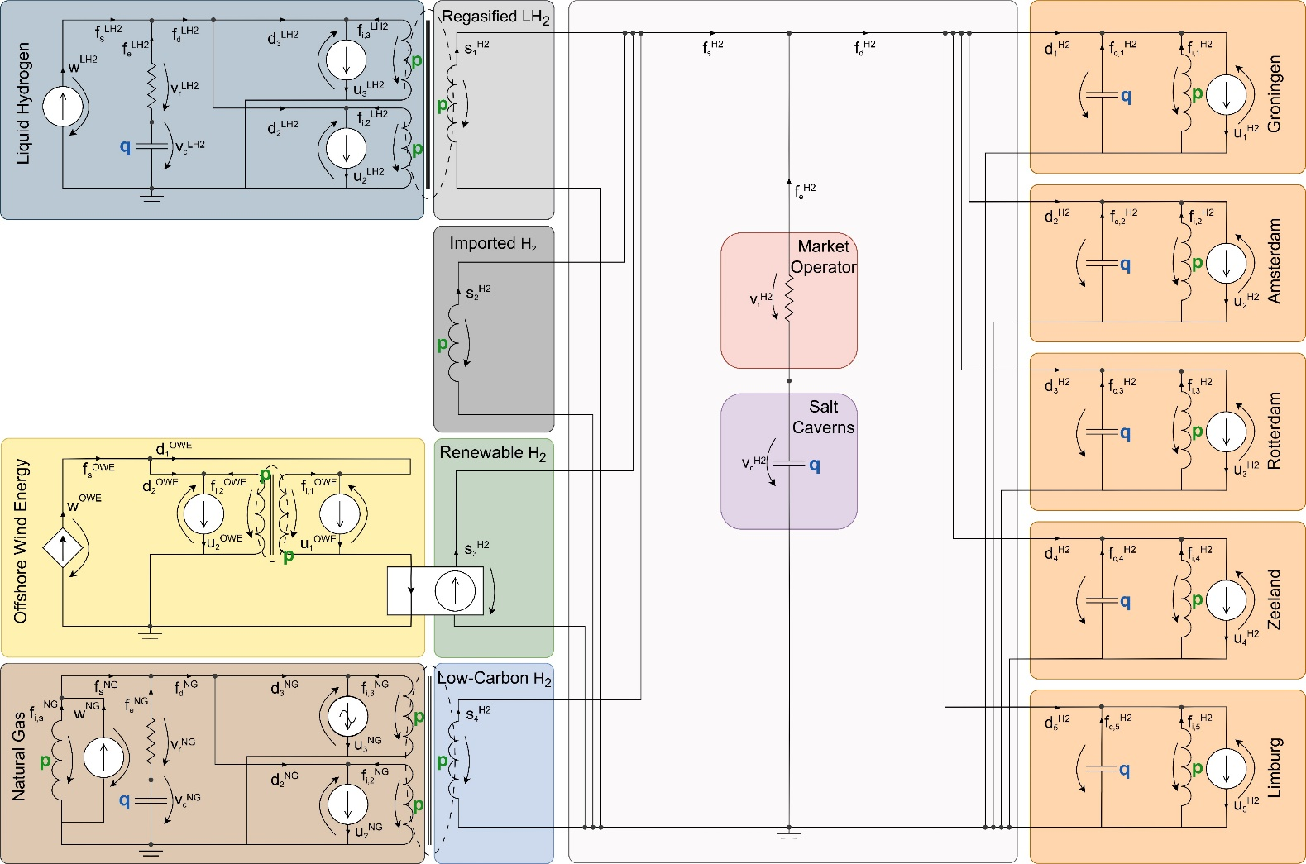
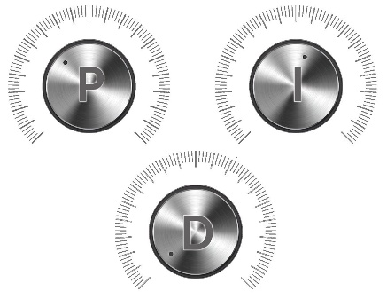
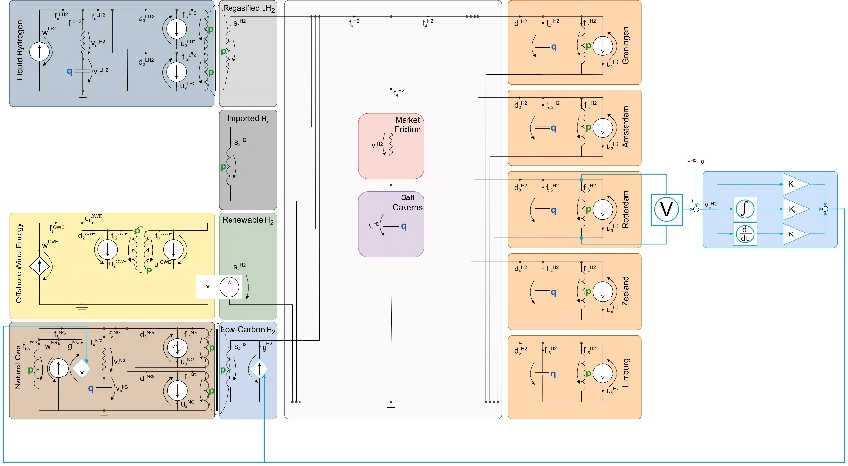


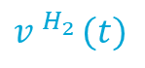
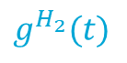
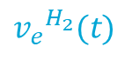
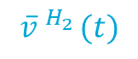
Regulatory Intervention as a PID Controller to Minimize Volatility
Proportional
$$\overline{v}.^{H_{2}}(t)$$
$${v_{e}}^{H_{2}}(t)$$
$$g^{H_{2}}(t)$$
Regulatory agent
Regulatory agent
$$v.^{H_{2}}(t)$$
_
Integral
Derivative
Context | Problem statement | ECT | Modeling & Design | Analysis | Control | Conclusions

Slide 10
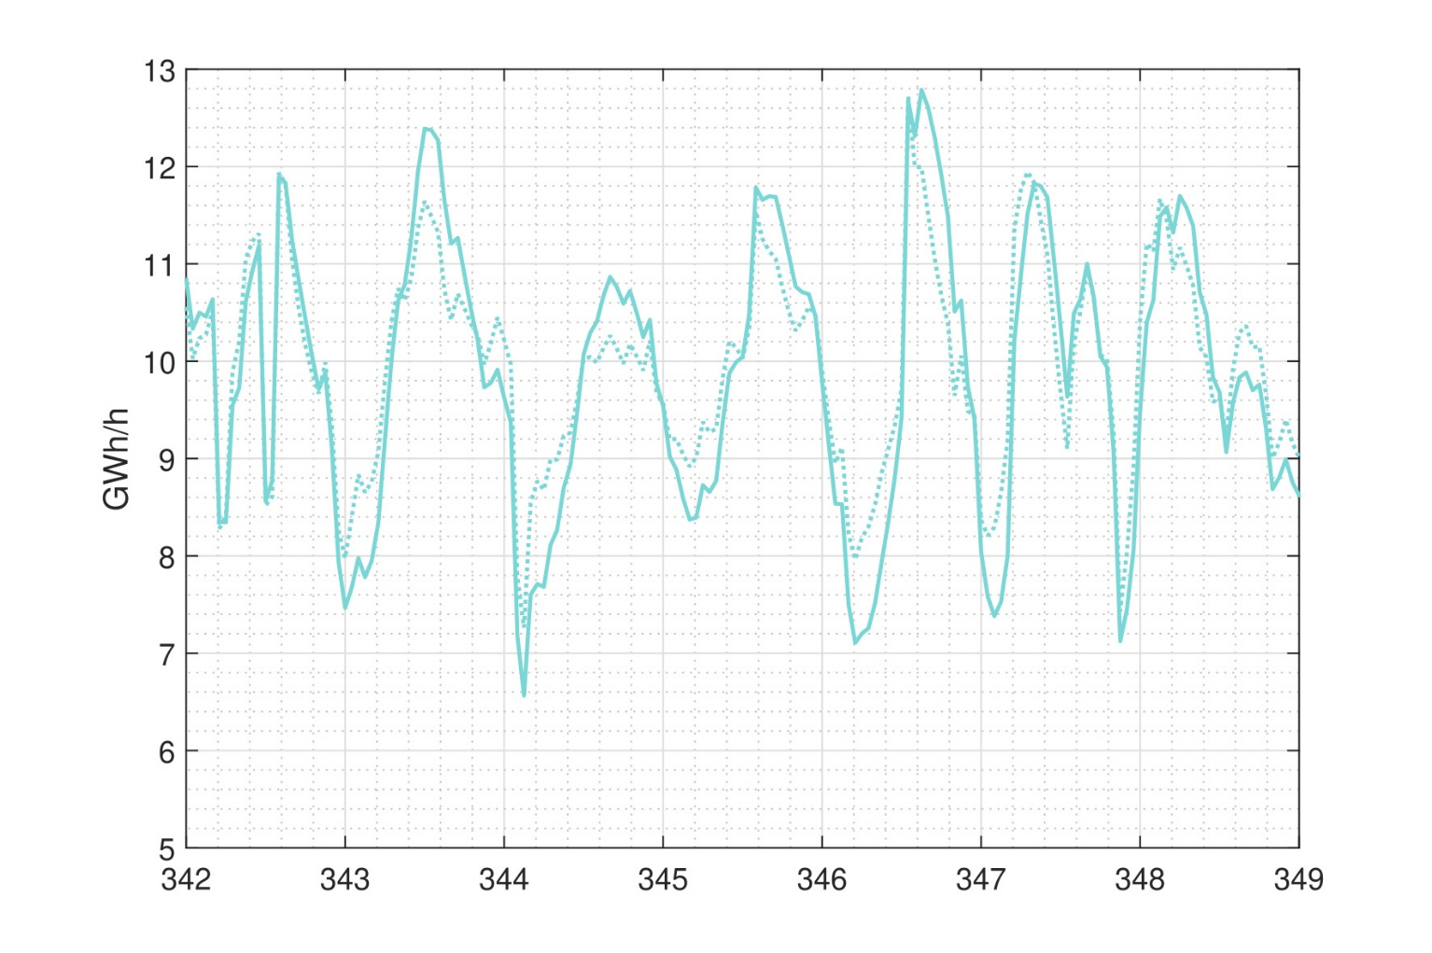
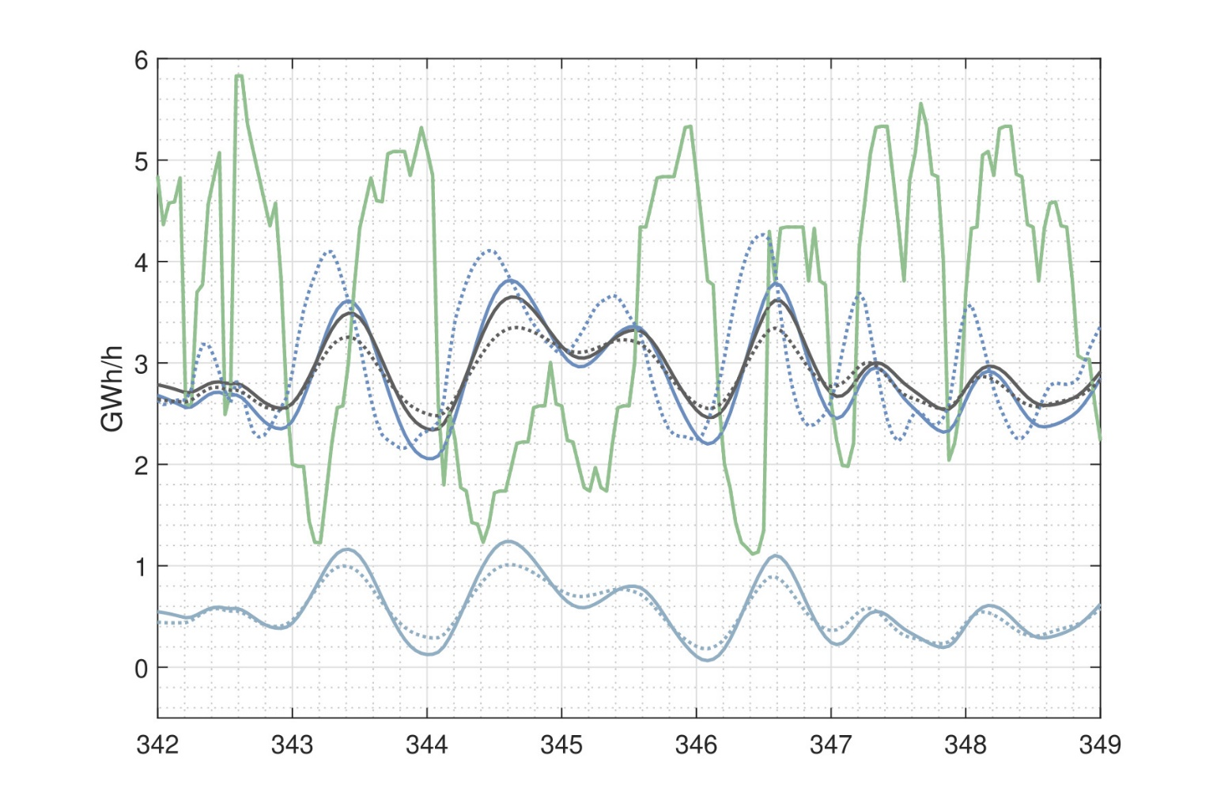
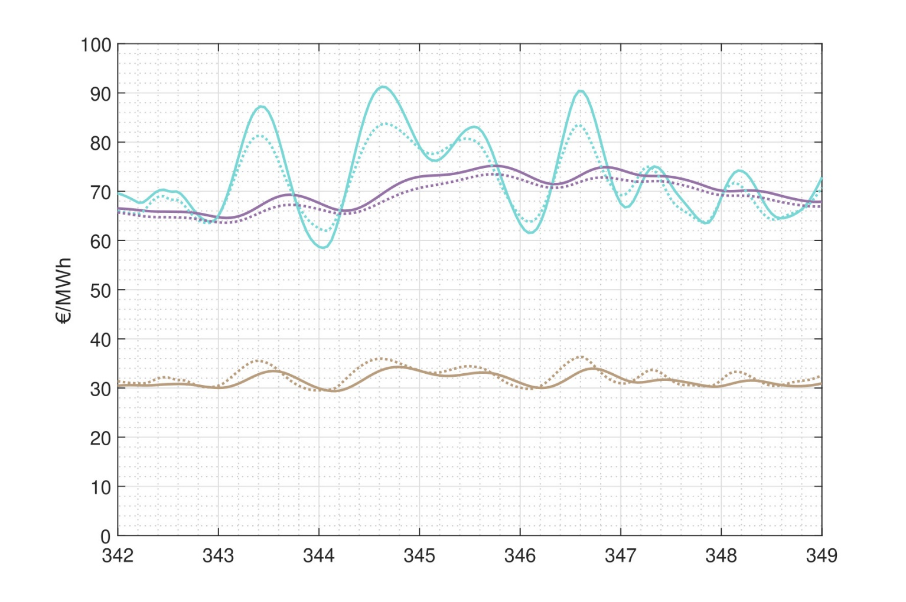
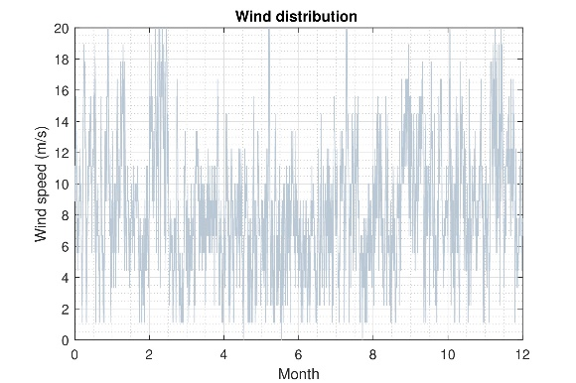
Dynamic Scenario Analysis: Regulatory Intervention
A
Hydrogen supply
Energy prices
Total hydrogen supply
Subsidy effects:
Hydrogen price - 2.1 %
Hydrogen supply + 0.9 %
Natural gas price + 3.3 %
Subsidy costs:
Total 9.3 M€
Percentage of total trade 3.3 %
Uncontrolled
V
Controlled
A
A
[4] B. Koirala, et. al, “Integrated electricity, hydrogen and methane system modelling framework: Application to the Dutch Infrastructure Outlook 2050,” Applied Energy, 2021. [5] IRENA, “Making the breakthrough: Green hydrogen policies and technology costs,” International Renewable Energy Agency, 2021.
A
V
Renewable
Low-carbon
Imported H2
Regasified H2
Hydrogen (all)
Liquid hydrogen
Natural gas
Context | Problem statement | ECT | Modeling & Design | Analysis | Control | Conclusions

Slide 11
Conclusions
A proof of concept of economic circuit theory:
Make revenue streams predictable
Quantify and minimize volatility
State-space representation
Network extensions using a port-based approach [8]
Seasonality in prices and storage levels
Optimizing wind-hydrogen production using MPC
Taking this work further:
Profitability
Further minimize volatility
[8] C. Hutters and M. Mendel, “A Multiport Network Framework for Dynamic Agent-Based Economic Modeling (Preprint),” 2024.
Context | Problem statement | ECT | Modeling & Design | Analysis | Control | Conclusions

Slide 12
Modeling, Design, Analysis, and Control of a Spot Market for Hydrogen
An Application of Economic Circuit Theory
Pien van den Berkmortel 03-07-2024

